Slide 1
Tutorial 7
By Jeremy Lim

Slide 2
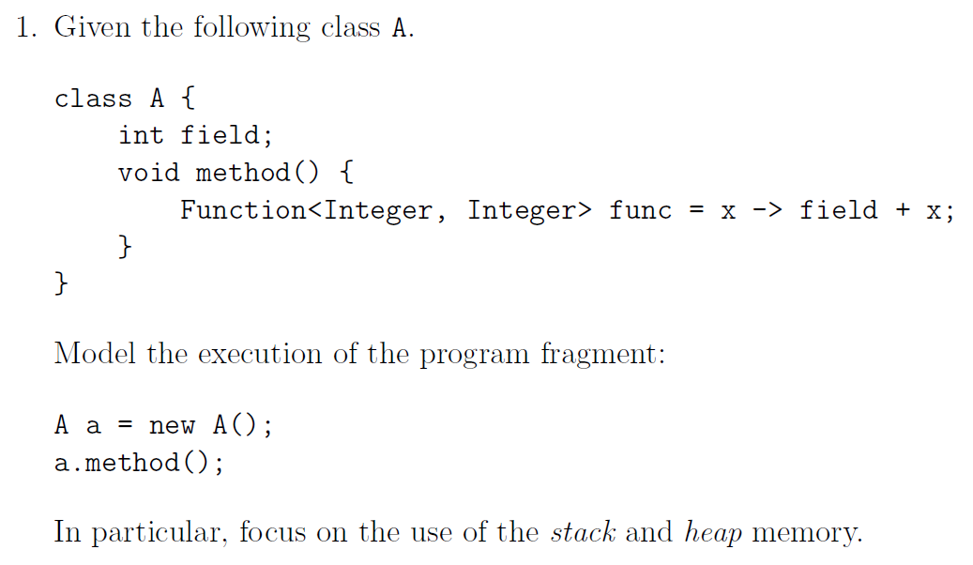
Q1: Stack and Heap in FP

Slide 3
Q1: Stack and Heap in FP
Variables and Primitives on Stack
Objects on Heap
Stack
Heap

Slide 4
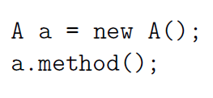
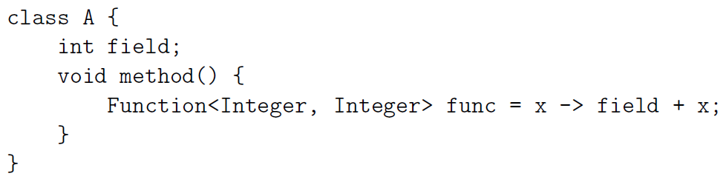
Q1: Stack and Heap in FP
Variables and Primitives on Stack
Objects on Heap
Stack
Heap
A a
class A
int Field
(No constructor)

Slide 5
Q1: Stack and Heap in FP
Variables and Primitives on Stack
Objects on Heap
Stack
Heap
A a
class A
int Field
a.method()
New scope

Slide 6
Q1: Stack and Heap in FP
Variables and Primitives on Stack
Objects on Heap
Stack
Heap
A a
class A
int Field
a.method()
Function<Int,Int> func

Slide 7
Q1: Stack and Heap in FP
Variables and Primitives on Stack
Objects on Heap
Stack
Heap
A a
class A
int Field
a.method()
Function<Int,Int> func
class ? implements Function
Converted into an anonymous
class implementing Function

Slide 8
Q1: Stack and Heap in FP
Variables and Primitives on Stack
Objects on Heap
Stack
Heap
A a
class A
int Field
a.method()
Function<Int,Int> func
class ? implements Function
Note: This is not executed, only created

Slide 9
Q1: Stack and Heap in FP
Variables and Primitives on Stack
Objects on Heap
Stack
Heap
A a
class A
int Field
End of method, delete scope – nothing pointing to func, so delete also

Slide 10
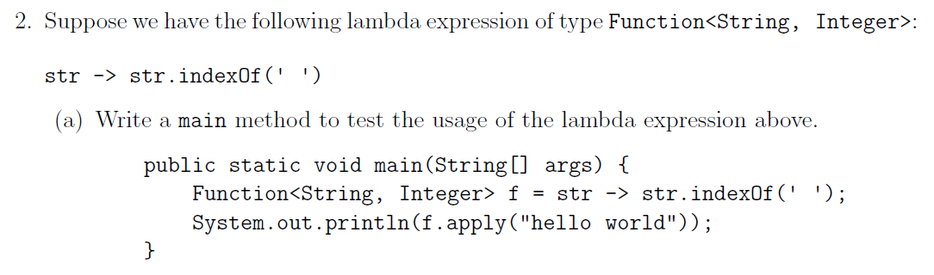
Q2a
(Answer)

Slide 11
Q2b: Lambda to Anonymous Class

Slide 12
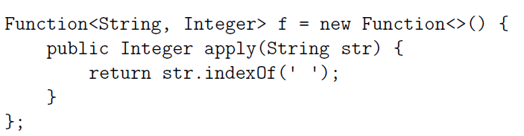
Q2b: Lambda to Anonymous Class
Create anonymous class first

Slide 13
Q2b: Lambda to Anonymous Class
Follow functional interface specification

Slide 14
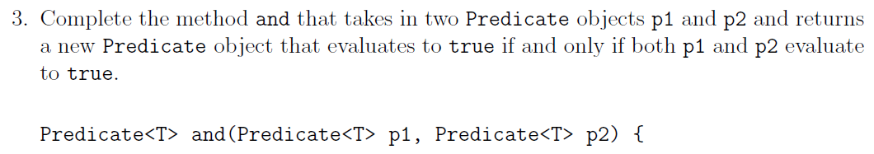
Q3: Combine 2 predicates

Slide 15
Q3: Combine 2 predicates
Check your return types!

Slide 16
Q3: Combine 2 predicates
Check your return types!
return p1.test(x) && p2.test(x);
WRONG
(returns boolean; what is x?)

Slide 17
Q3: Combine 2 predicates
Check your return types!
return x -> p1.test(x) && p2.test(x);
Correct
Function from x to boolean, i.e. Predicate

Slide 18
Q3: Combine 2 predicates
return x -> p1.test(x) && p2.test(x);
Extra: As anonymous class?

Slide 19
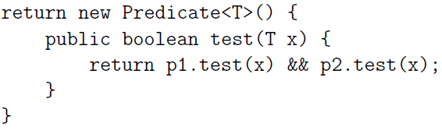
Q3: Combine 2 predicates
return x -> p1.test(x) && p2.test(x);
Extra: As anonymous class?

Slide 20
Q3: Combine 2 predicates
return x -> p1.test(x) && p2.test(x);
Extra: As anonymous class?
X is of type T: Predicate<T> $≡$ Function<T, Boolean>
Argument is type T

Slide 21
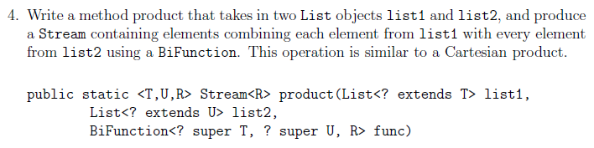

Q4
$$f\left(A,B\right)=A×B$$

Slide 22
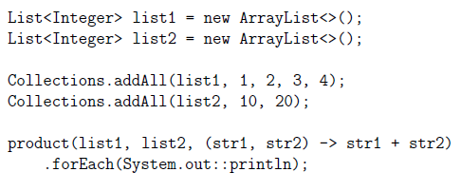
Q4
11
21
12
22
13
23
14
24

Slide 23
Q4
Idea: Convert List list1 to Stream
Combine list1 with every element of list2 to produce another stream
Map Function<T,Stream<T>> to every element of list1
Use flatMap!

Slide 24
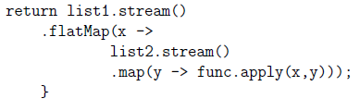
Q4
Idea: Convert List list1 to Stream
Combine list1 with every element of list2 to produce another stream
Map Function<T,Stream<T>> to every element of list1
Use flatMap!

Slide 25
Q4
Idea: Convert List list1 to Stream
Combine list1 with every element of list2 with given BiFunction to produce another stream
Map Function<T,Stream<T>> to every element of list1
Use flatMap!
X: Element of list1
Y: Element of list2

Slide 26
Q4
x
list2
1
+
10,20,30
=
11
21
31
+
10,20,30
…
2
3
+
10,20,30

Slide 27
Q4
y
x
10
+
1
20
+
1
20
+
1

Slide 28
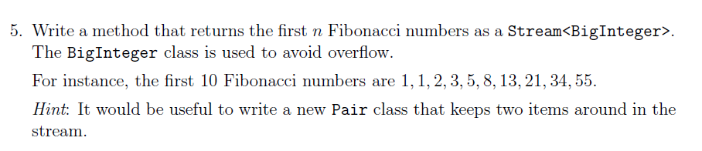
Q5: Fibonacci
1
1
2
3
5
8
13
21

Slide 29
Q5: Fibonacci
1
1
2
3
5
8
13
21

Slide 30
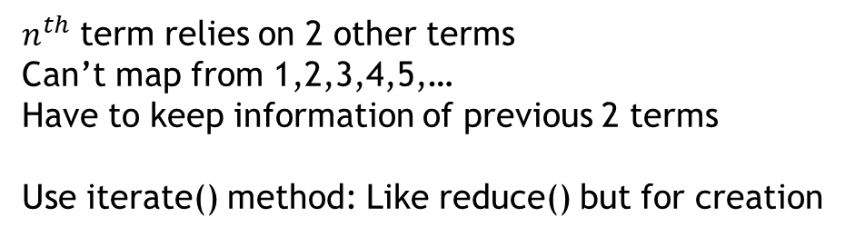
Q5: Fibonacci
1
1
2
3
5
8
13
21
$n^{th}$ term relies on 2 other terms
Can’t map from 1,2,3,4,5,…
Have to keep information of previous 2 terms
Use iterate() method: Like reduce() but for creation

Slide 31
Iterate()
Iterate(2, x -> x + 2): 2,4,6,8,10,…

Slide 32
Q5: Fibonacci
1
1
2
3
5
8
13
21

Slide 33
Q5: Fibonacci
1
1
2
3
5
8
13
21

Slide 34
Q5: Fibonacci
1
1
2
3
5
8
13
21
$i^{th}$ term: Purple arrow, second component of next term

Slide 35
Q5: Fibonacci
First term is 1
Stream.iterate([0,1], …)
1
1

Slide 36
Q5: Fibonacci
Generate next pair of numbers where the second number is the next term
Stream.iterate([0,1], [x,y] -> …)

Slide 37
Q5: Fibonacci
Generate next pair of numbers where the second number is the next term
Stream.iterate([0,1], [x,y] -> [y, x+y])
x
y
x+y
y
x+y
???
(Not generated yet)

Slide 38
Q5: Fibonacci
Stream.iterate([0,1], [x,y] -> [y, x+y]) .map([x,y] -> y) .limit(n)
Collapse down to second number only

Slide 39
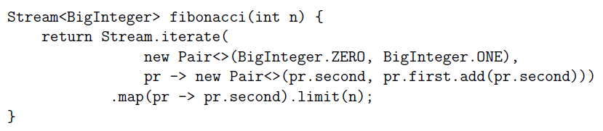
Q5: Fibonacci
Stream.iterate([0,1], [x,y] -> [y, x+y]) .map([x,y] -> y) .limit(n)

Slide 40
Q5: Fibonacci
Stream.iterate([0,1], [x,y] -> [y, x+y]) .map([x,y] -> y) .limit(n)

Slide 41
Admin
Google survey will be sent out later
1 question: Tell me what you want to revise in the next few weeks

